Slide 1
Programming fundamentals
Section 7

Slide 2
Break Statement
The break statement has two uses.
1- to terminate a case in the switch statement.
2- to force immediate termination of a loop.
When the break statement is encountered inside a loop, the loop is immediately terminated and program control resumes at the next statement following the loop.

Slide 3
Break Example
C++ program to add all number entered by user until user enters 0.
#include <iostream> using namespace std; void main() {float number, sum = 0; while (true) {cout << "Enter a number: "; cin >> number; if (number != 0) sum += number; else break; } cout << "Sum = " << sum << endl; system("Pause"); }

Slide 4
Continue Statement
continue statement works similar to break statement. The only difference is that break statement terminates the loop whereas continue statement passes control to the conditional test i.e., where the condition is checked.

Slide 5
Continue Example
C++ program to display integer from 1 to 10 except 6 and 9.
#include <iostream> using namespace std; void main() { for (int i = 1; i <= 10; ++i) { if (i == 6 || i == 9) continue; cout << i << "\t"; } system("Pause"); }

Slide 6
Functions
There are two types of function:
Library Function
User-defined Function

Slide 7
Library Function
Library functions are the built-in function in C++ programming.
Programmer can use library function by invoking function directly; they don't need to write it themselves.

Slide 8
Library Function
#include <iostream> #include <math.h> using namespace std; void main() { double number, squareRoot; cout << "Enter a number: "; cin >> number; // sqrt() is a library function to calculate square root squareRoot = sqrt(number); cout << "Square root of " << number << " = " << squareRoot<<endl; system("Pause"); }

Slide 9
User-defined Function
The General Form:
The ret-type specifies the type of data that the function returns. A function may return any type of data except an array.
The parameter list is a comma-separated list of variable names and their associated types that receive the values of the arguments when the function is called.
- A function may be without parameters However, even if there are no parameters, the parentheses are still required.
ret-type function-name (type var1, type var2, . . . , type varN) { body of the function }

Slide 10
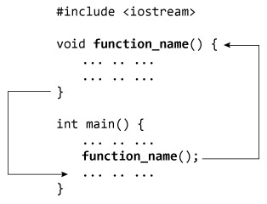
Scope Rules of Functions
The code that constitutes the body of a function is hidden from the rest of the program and, unless it uses global variables or data.
How user-defined function works in C Programming?

Slide 11
Function prototype (declaration)
If a user-defined function is defined after main() function, compiler will show error. It is because compiler is unaware of user-defined function, types of argument passed to function and return type.
In C++, function prototype is a declaration of function without its body to give compiler information about user-defined function.
Put the declaration before main to avoid compiler error:
ret-type function-name (type var1, type var2, . . . , type varN);

Slide 12
Function Definition
The function itself is referred as function definition.
It includes Return type, function name, function parameters and function body.

Slide 13
Function Call
To execute the codes of function body, the user-defined function needs to be called inside main() function.
function-name (Parameter1,Parameter2, …);

Slide 14
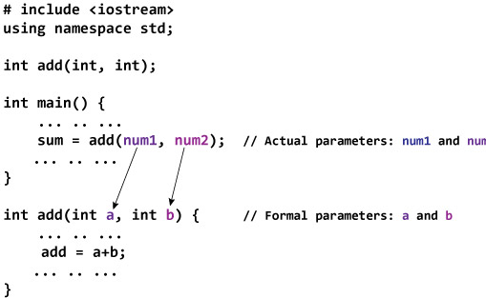
Passing Arguments to Function

Slide 15
Return Statement
A function can return a single value to the calling program using return statement.
return x;

Slide 16
Example
Write a program in C++ to check whether a number is prime or not. Using functions
#include <iostream> #include<math.h> using namespace std; int prime(int num) { for (int i = 2; i <= sqrt(num); i++) //better than num/2 { if (num % i == 0) { cout << "not prime" << endl; return 0; } } cout << "prime " << endl; } | int main() { int num; cout << " Enter your number"; cin >> num; prime(num); system("Pause"); return 0; }

Slide 17
Example
Function to return the max of 5 numbers entered by user.(using while).
#include <iostream> using namespace std; float max() { int count = 1; float x; cin >> x; float max = x; while (count<=4) { cin >> x; if (max < x) max = x; | count++; } return max; } void main() { cout << " Enter five numbers"; cout<<"max = "<<max()<<endl; system("Pause"); }

